Slide 1

MACHINE LEARNING WALKTHROUGH
TELECOM ANALYTICS
Telecom Customer Churn Prediction
From messy data to a deployed prediction form.
End-to-end project

Slide 2
THE OBJECTIVE
Predict churn early enough to act
ROWS
1,300
Customer records
Identify customers likely to leave before revenue is lost.
COLUMNS
23
Details, services, billing, support, churn
Source file · telecom_churn_raw.csv

Slide 3
DATA AUDIT
The raw file hid problems in almost every column
Sixteen columns contained missingness, duplicates, inconsistent labels, or implausible values.
Issue | Representative examples | Why it matters
Missingness | -- · Not Available · ? · blanks · NaN |  | One meaning, many spellings
Identity | 35 exact duplicates · repeated customer_id | Inflated evidence
Validity | Text numbers · impossible dates · extremes | Broken features and leakage risk

Slide 4
CLEANING DECISIONS
Six decisions turned messy records into model-ready data
01
02
Map
Normalize
Hidden missing values → NaN.
Strip text, lowercase, merge variants.
03
04
Convert
Deduplicate
Numeric text and dates become usable types.
1,300 → 1,251 rows.
05
06
Screen
Impute
Negative and above-Q3 + 3×IQR values → NaN.
Median numeric, mode categories, drop missing churn.
Output · telecom_churn_clean.csv · 1,239 rows · raw file untouched

Slide 5
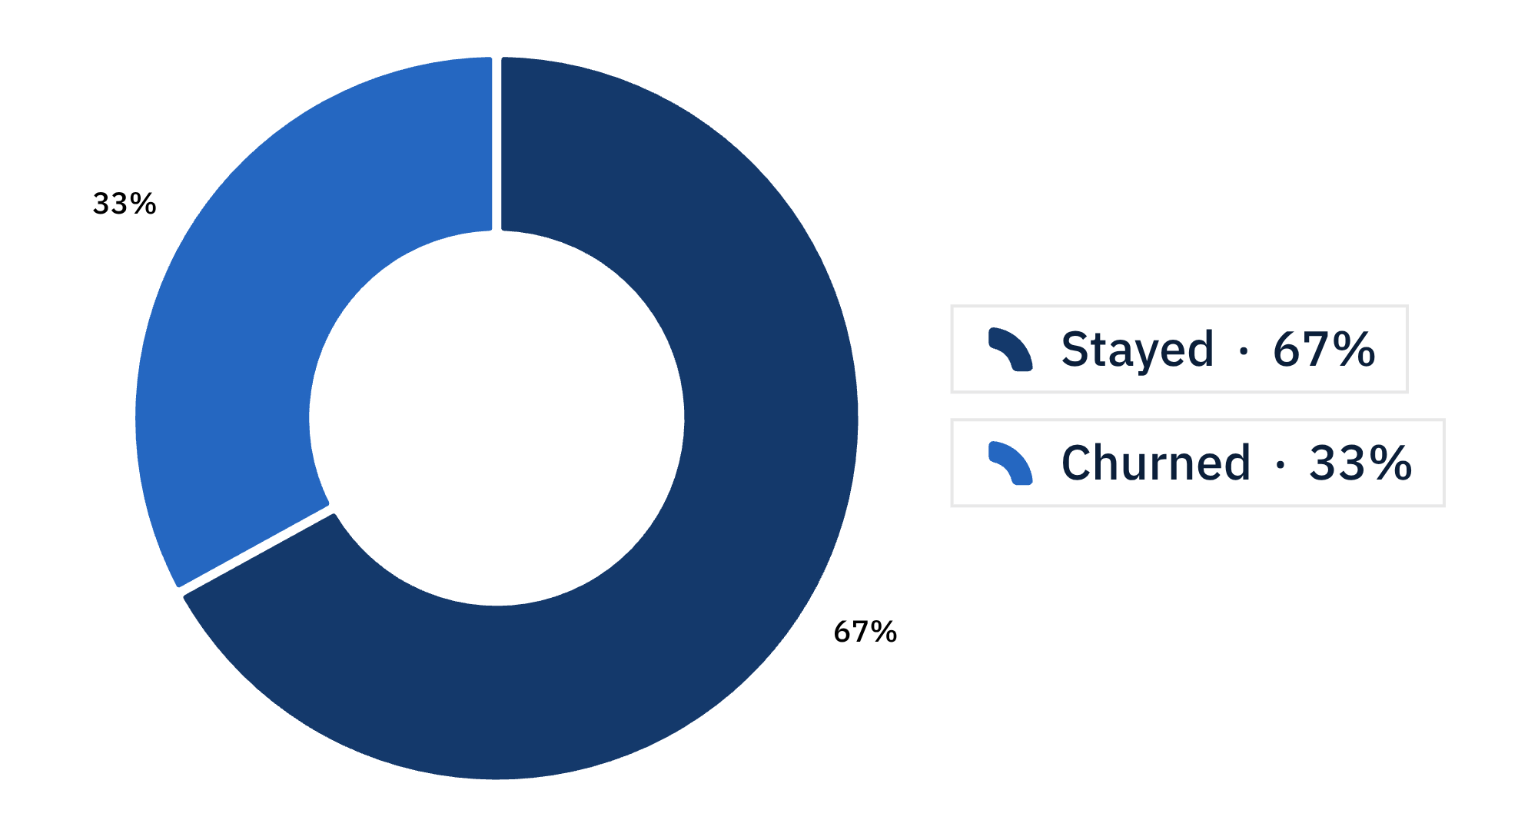


One in three customers churned
TARGET BALANCE
33%
churned
One in three customers left.
Accuracy alone is not enough when the minority class matters.

Slide 6
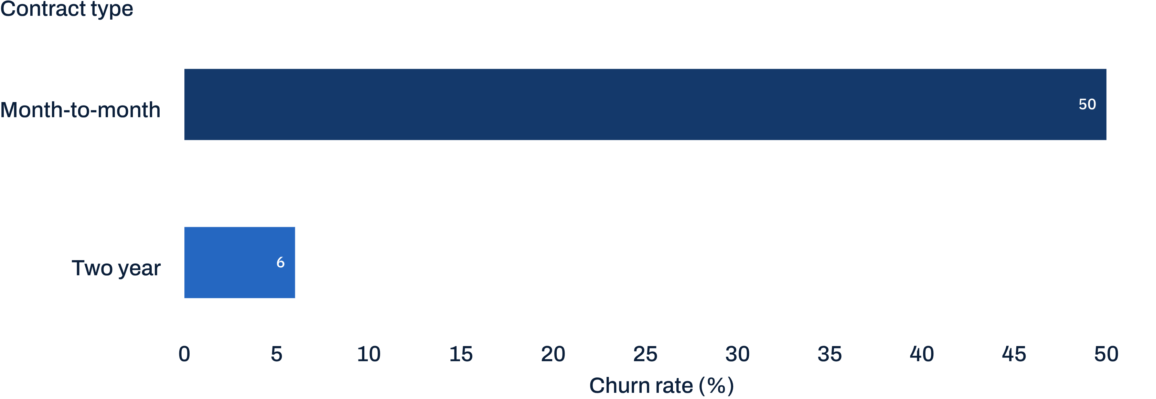
CONTRACT SIGNAL
Month-to-month contracts carry the most risk
Longer commitments align with much lower churn.
50% churned on month-to-month contracts versus about 6% on two-year contracts.

Slide 7

WHAT THE COMPARISON SAYS
Churned customers had shorter tenure
Newer customers are the visible risk segment.
CHURNED
OTHERS
19
26
months median tenure
months median tenure
The seven-month gap makes early-tenure intervention worth testing.

Slide 8
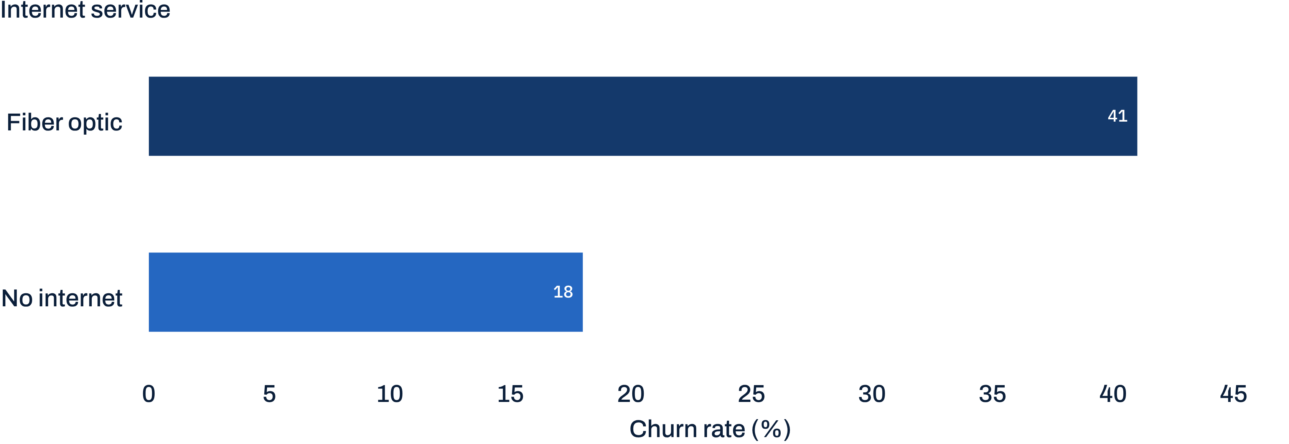

SERVICE SIGNAL
Fiber optic customers churned most
The highest-risk internet-service segment in this dataset.
About 41% churned with fiber optic service versus about 18% with no internet service.

Slide 9
BILLING SIGNAL
AVERAGE MONTHLY CHARGES
Higher monthly charges aligned with higher churn
CHURNED
OTHERS
80
70
Average monthly charges were about 80 for churned customers versus about 70 for others.
average monthly charge
average monthly charge

Slide 10


FEATURE ENGINEERING
Feature engineering kept the pipeline honest
The model only sees transformations learned from training data.
01
02
Derived spend
New customer
avg_spend_per_month = total_charges / (tenure + 1)
new_customer = 1 when tenure is 12 months or less
03
04
Encode
Standardize
One-hot encoding fitted inside the pipeline.
Numeric scaling fitted inside the pipeline.
05
Split
80/20 stratified train-test split.
Why it matters: preprocessing stays inside the pipeline, and the churn ratio is preserved.

Slide 11
BASELINE MODELS
Logistic regression led the baseline on F1
The simplest baseline produced the strongest balance of precision and recall.
Model | Accuracy | Precision | Recall | F1
Logistic Regression | 0.730 | 0.609 | 0.481 | 0.538
Decision Tree | 0.673 | 0.500 | 0.469 | 0.484
Random Forest | 0.718 | 0.587 | 0.457 | 0.514
XGBoost | 0.718 | 0.596 | 0.420 | 0.493
F1 is the lead metric because the churn class is a meaningful minority, not a rounding error.

Slide 12
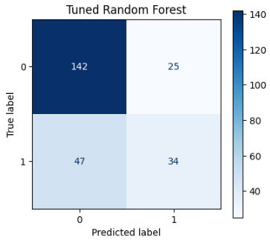


HYPERPARAMETER TUNING
Tuning improved precision, but not the overall winner
We tried 5 different settings for Random Forest and XGBoost, tested each one 3 times, and kept the settings with the best F1 score.
TUNED RANDOM FOREST
TUNED XGBOOST
Confusion matrix
Confusion matrix

Slide 13
MODEL SELECTION
Model | Accuracy | Precision | Recall | F1
Logistic Regression | 0.730 | 0.609 | 0.481 | 0.538
Random Forest | 0.718 | 0.587 | 0.457 | 0.514
XGBoost | 0.718 | 0.596 | 0.420 | 0.493
Tuned Random Forest | 0.710 | 0.576 | 0.420 | 0.486
Decision Tree | 0.673 | 0.500 | 0.469 | 0.484
Tuned XGBoost | 0.718 | 0.608 | 0.383 | 0.470
The Logistic Regression became the chosen final model
JUSTIFICATION
Logistic Regression is the final model. It scored highest on all four metrics (F1 0.538, recall 0.481), and the tuned models
did not beat it. It is also simple and fast, and it gives a clear churn probability for the form.
FINAL MODEL

Slide 14
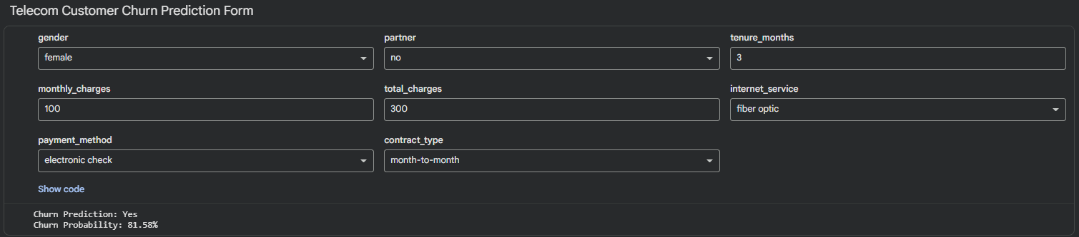
DEPLOYMENT
PREDICTION FORM
Deployment turns a model into an action
Saved with joblib · churn_model.pkl
Three takeaways
New, month-to-month, fiber optic customers with high charges are the highest-risk group.
Clean data mattered more than complex models.
Next action: offer longer contracts or targeted discounts.
Output · churn prediction plus churn probability
Thank you · GitHub repository: [link]

